Slide 1

Prototype for our app
Pankaj Naroam - 1703100

Slide 2
Login Page
Background e.g. colour or picture
Logo
Username
Password
Login
Don’t have an account click →
Sign up

Slide 3
Signup Page
Background e.g. colour or picture
Logo
Name
Surname
Create username
Create Password
Birthdate
Fav sport
Signup
Already have an account click →
Login

Slide 4
User Page
Background e.g. colour or picture
On going tournament
Cricket
Create Tournament
Dropdown
Football
Basketball and all the game the user creates
Join Tournament
Create Game
Your Current Tournament
Past Tournament

Slide 5
Join Tournament Page
Background e.g. colour or picture
Active Tournaments
T1 – click to join
T2 – click to join
T3 – click to join
After clicking on any tournament to join, it will go to a page where it will ask few questions about team name and so on….
T4 – click to join
T5 – click to join
T6 – click to join

Slide 6
Create Game Page
Background e.g. colour or picture
G Name
Rules
Define rules
Player limit
Unnamed
unnamed
Back button
Create Game

Slide 7
Create Tournament Page
Background e.g. colour or picture
Display Game Name
T Name
T rules
Number of team
Number of Players
Unique T invitation link
Unique code to view points table
Back button
Create T
Generate bracket

Slide 8
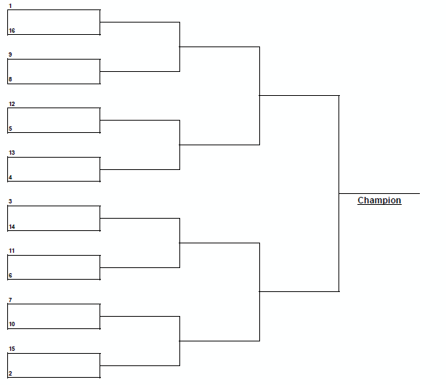
Bracket page
Background e.g. colour or picture
Tournaments faceoff

Slide 9
Your Current Tournament
Background e.g. colour or picture
Your tournaments
T1 – click to view
T2 – click to view
Log of the tournament – e.g. Name of the tournament, date and time and venue(if any)
T3 – click to view
T4 – click to view
T5 – click to view
T6 – click to view
Back button
Points table
View Bracket

Slide 10
Past Tournament
Background e.g. colour or picture
Your History
T1 – click to view
T2 – click to view
Log of the tournament – e.g. Name of the tournament, champions, game name,
T3 – click to view
T4 – click to view
T5 – click to view
T6 – click to view
Back button
Points table
View Bracket

